Slide 1
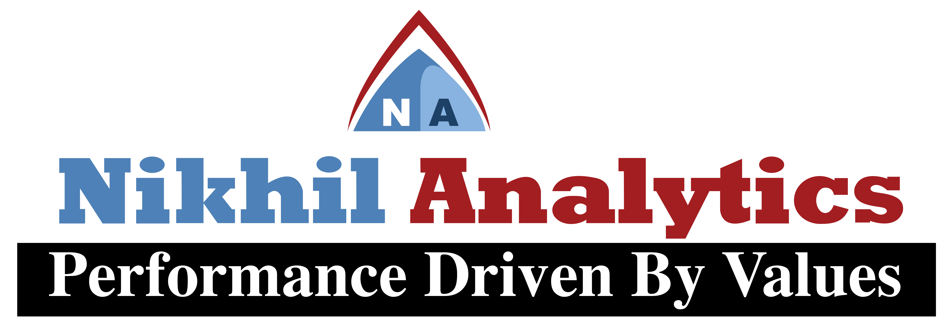
Session Vii
By
Alok Ranjan
Nikhil analytics

Slide 2
Agenda of Session Vii
Ridge Regression Algorithm and its Application using Python

Slide 3

Ridge Regression Algorithm
Two of the most prolific regression techniques used in the creation of parsimonious models involving a great number of features are Ridge and Lasso regressions respectively.
Lasso and Ridge regression is also known as Regularization method which means it is used to make the model improved.

Slide 4
What is Ridge Regression?
Ridge Regression is a modification in the cost function, by the addition of a penalty having a similar value as the coefficient’s magnitude’s square, be done in the case of Ridge Regression.

